Slide 1
Information Security
Van K Nguyen - HUT
Program (Software) Security

Slide 2
MALICIOUS PROGRAMS
Sep 2009
Information Security by Van K Nguyen Hanoi University of Technology

Slide 3
Malware: software designed to infiltrate or damage a computer system without the owner's informed consent
Spyware: software designed to intercept or take partial control over the user's interaction with the computer, without the user's informed consent
  secretly monitors the user's behavior
  collect various types of personal information
Sep 2009
Information Security by Van K Nguyen Hanoi University of Technology

Slide 4
Trapdoor/backdoor
Secret entry point into a system
  Special login into system (circumvents normal security procedures.)
Presents a security risk
Can be for good purpose as for Troubleshooting or maintenance
Can be bad in wrong hand - Malicious intent
Sep 2009
Information Security by Van K Nguyen Hanoi University of Technology

Slide 5
Logic bomb
Embedded in legitimate programs
Activated when specified conditions met
  E.g., presence/absence of some file; Particular date/time or particular user
When triggered, typically damages system: Modify/delete files/disks
Sep 2009
Information Security by Van K Nguyen Hanoi University of Technology

Slide 6
Trojan Horse
Program with an covert effect besides the expected
  Appears normal/expected
  Covert effect violates security policy
User tricked into executing a trojan horse
  Look normal but behind the scene, covert effect performed with user’s authorization
Sep 2009
Information Security by Van K Nguyen Hanoi University of Technology

Slide 7
Virus
Self-replicating code
  Like replicating Trojan horse
  Alters normal code with “infected” version
Generally tries to remain undetected
Operates when infected code executed
  If spread condition then
  For target files
  if not infected then alter to include virus
  Perform malicious action
  Execute normal program
Sep 2009
Information Security by Van K Nguyen Hanoi University of Technology

Slide 8
Virus types
Problem: How to ensure virus “carrier” executed?
  Place in boot sector of disk OR in executales which are likely to be used
Boot Sector
  Run on any boot
  Propagate by altering boot disk creation
Executable
  Malicious code placed at beginning of legitimate program
  Runs when application run
  Application then runs normally
Sep 2009
Information Security by Van K Nguyen Hanoi University of Technology

Slide 9
Virus Types
Terminate but Stay Resident (TSRs)
  Stays active in memory after application completes
  Allows infection of previously unknown files
    Trap calls that execute a program
Stealth
  Conceal Infection
    Trap read and disinfect
    Let execute call infected file
  Encrypt virus
    Prevents “signature” to detect virus
  Polymorphism
    Change virus code to prevent signature
Sep 2009
Information Security by Van K Nguyen Hanoi University of Technology

Slide 10
Macro Virus
Infected “executable” isn’t machine code
  Relies on something “executed” inside application data ➔ Macros
Properties specific to these viruses
  Architecture-independent
  Application-dependent
Sep 2009
Information Security by Van K Nguyen Hanoi University of Technology

Slide 11
Worms
Runs independently
  Does not require a host program
  Propagates a fully working version of itself to other machines
Carrie a payload performing hidden tasks
  Backdoors, spam relays, DDoS agents; …
Phases
  Probing → Exploitation → Replication → Payload
Sep 2009
Information Security by Van K Nguyen Hanoi University of Technology

Slide 12
Cost of Worm Attacks
Morris worm, 1988
  Infected approximately 6,000 machines
    10% of computers connected to the Internet
  cost ~ $10 million in downtime and cleanup
Code Red worm, July 16 2001
  Direct descendant of Morris’ worm
  Infected more than 500,000 servers
  Caused ~ $2.6 Billion in damages,
Love Bug worm: May 3, 2000, $8.75 billion
Statistics: Computer Economics Inc., Carlsbad, California
Sep 2009
Information Security by Van K Nguyen Hanoi University of Technology

Slide 13
Morris Worm
Released November 1988
  Program spread through Digital, Sun workstations
  Exploited Unix security vulnerabilities
Consequences
  No immediate damage from program itself
  Replication and threat of damage
    Load on network, systems used in attack
    Many systems shut down to prevent further attack
Sep 2009
Information Security by Van K Nguyen Hanoi University of Technology

Slide 14
Morris Worm
Two parts
  Program to spread worm
    look for other machines that could be infected
    try to find ways of infiltrating these machines
  Vector program (99 lines of C)
    compiled and run on the infected machines
    transferred main program to continue attack
Security vulnerabilities
  fingerd – Unix finger daemon
  sendmail - mail distribution program
  Trusted logins (.rhosts)
  Weak passwords
Sep 2009
Information Security by Van K Nguyen Hanoi University of Technology

Slide 15
Morris Worm: Spread Mechanisms
Sendmail
  Exploit debug option in sendmail to allow shell access
Fingerd
  Exploit a buffer overflow in the gets function
  Apparently, this was the most successful attack
Rsh
  Exploit trusted hosts
  Password cracking
Sep 2009
Information Security by Van K Nguyen Hanoi University of Technology

Slide 16
sendmail
Worm used debug feature
  Opens TCP connection to machine's SMTP port
  Invokes debug mode
    places 40-line C program in a temporary file
    Compiles and executes this program
      Opens socket to machine that sent script
      Retrieves worm main program, compiles it and runs
Sep 2009
Information Security by Van K Nguyen Hanoi University of Technology

Slide 17
Finger
An utility that allows users to obtain information about other users.
  the full name or login name of a user
    whether or not a user is currently logged in,
  telephone numbers, maybe, and other info
fingerd: a daemon, or background process, to service remote requests using the finger protocol
The bug exploited to break fingerd: overrunning the buffer for input
  Gets, a standard C library, takes input to a buffer without doing any bounds checking
Sep 2009
Information Security by Van K Nguyen Hanoi University of Technology

Slide 18
fingerd
Array bounds attack
  Fingerd expects an input string
  Worm writes long string to internal 512-byte buffer
Attack string
  Includes machine instructions
  Overwrites return address
  Invokes a remote shell
  Executes privileged commands
Sep 2009
Information Security by Van K Nguyen Hanoi University of Technology

Slide 19
Remote shell
Unix trust information
  /etc/host.equiv – system wide trusted hosts file
  /.rhosts and ~/.rhosts – users’ trusted hosts file
Worm exploited trust information
  Examining files that listed trusted machines
  Assume reciprocal trust
    If X trusts Y, then maybe Y trusts X
Password cracking
  Worm was running as daemon (not root) so needed to break into accounts to use .rhosts feature
  Read /etc/passwd, used ~400 common password strings & local dictionary to do a dictionary attack
Sep 2009
Information Security by Van K Nguyen Hanoi University of Technology

Slide 20
The worm itself
Program is shown as 'sh' when ps
  Clobbers argv array so a 'ps' will not show its name
  Opens its files, then unlinks (deletes) them so can't be found
    Since files are open, worm can still access their contents
Tries to infect as many other hosts as possible
When worm successfully connects, forks a child to continue the infection while the parent keeps trying new hosts
find targets using several mechanisms: 'netstat -r -n‘, /etc/hosts,
…
Worm did not:
  Delete system's files, modify existing files, install trojan horses, record or transmit decrypted passwords, capture superuser privileges
Sep 2009
Information Security by Van K Nguyen Hanoi University of Technology

Slide 21
Detecting Morris Internet Worm
Files
  Strange files appeared in infected systems
  Strange log messages for certain programs
System load
  Infection generates a number of processes
  Password cracking uses lots of resources
  Systems were reinfected => number of processes grew and systems became overloaded
    Apparently not intended by worm’s creator
  Thousands of systems were shut down
Sep 2009
Information Security by Van K Nguyen Hanoi University of Technology

Slide 22
Buffer Overflow
Buffer overflow occurs when a program or process tries to store more data in a buffer than the buffer can hold
Very dangerous because the extra information may:
  Affect user’s data
  Affect user’s code
  Affect system’s data
  Affect system’s code
Sep 2009
Information Security by Van K Nguyen Hanoi University of Technology

Slide 23
Why Does Buffer Overflow Happen?
No check on boundaries
  Programming languages give user too much control
  Programming languages have unsafe functions
  Users do not write safe code
C and C++, are more vulnerable because they provide no built-in protection against accessing or overwriting data in any part of memory
Sep 2009
Information Security by Van K Nguyen Hanoi University of Technology

Slide 24
Why Buffer Overflow Matter
Overwrites:
  other buffers
  variables
  program flow data
Results in:
  erratic program behavior
  a memory access exception
  program termination
  incorrect results
  breach of system security
Sep 2009
Information Security by Van K Nguyen Hanoi University of Technology

Slide 25
Basic Example
A program has defined two data items which are adjacent in memory
  an 8-byte-long string buffer, A, and a two-byte integer, B.
  Initially, A contains nothing but zero bytes, and B contains the number 3
Now, the program attempts to store the character string "excessive" in the A buffer, followed by a zero byte to mark the end of the string
  By not checking the length of the string, it overwrites the value of B
Sep 2009
Information Security by Van K Nguyen Hanoi University of Technology

Slide 26
Stack-based exploitation
A malicious user may exploit stack-based buffer overflows to manipulate the program in one of several ways:
  By overwriting a local variable that is near the buffer in memory on the stack to change the behaviour of the program which may benefit the attacker.
  By overwriting the return address in a stack frame. Once the function returns, execution will resume at the return address as specified by the attacker, usually a user input filled buffer.
  By overwriting a function pointer,^{[1]} or exception handler, which is subsequently executed.
Sep 2009
Information Security by Van K Nguyen Hanoi University of Technology

Slide 27
Stack
1
2
“XXX…
00123411
m
n
smt
int i = 7;
…
return 0;
Sep 2009
Information Security by Van K Nguyen Hanoi University of Technology

Slide 28
WEB SECURITY
Sep 2009
Information Security by Van K Nguyen Hanoi University of Technology

Slide 29
SQL injection
SQL injection is a code injection technique that exploits a security vulnerability occurring in the database layer of an application.
The vulnerability is present when user input is either incorrectly filtered for string literal escape characters embedded in SQL statements or user input is not strongly typed and thereby unexpectedly executed.
It is an instance of a more general class of vulnerabilities that can occur whenever one programming or scripting language is embedded inside another.
SQL injection attacks are also known as SQL insertion attacks.
Sep 2009
Information Security by Van K Nguyen Hanoi University of Technology

Slide 30
Example
Consider: SELECT * FROM users WHERE name = 'a' OR 't'='t';
Set username as: a' or 't'='t
Then get: SELECT * FROM users WHERE name = 'a' OR 't'='t';
Sep 2009
Information Security by Van K Nguyen Hanoi University of Technology

Slide 31
Another example
Use:
a';DROP TABLE users; SELECT * FROM data WHERE 't' = 't
So:
SELECT * FROM users WHERE name = 'a';DROP TABLE users; SELECT * FROM DATA WHERE 't' = 't';
Sep 2009
Information Security by Van K Nguyen Hanoi University of Technology

Slide 32
Cross Site Scripting (XSS)
Recall the basics
  scripts embedded in web pages run in browsers
  scripts can access cookies
    get private information
  and manipulate DOM objects
    controls what users see
  scripts controlled by the same-origin policy
Why would XSS occur
  Web applications often take user inputs and use them as part of webpage
Sep 2009
Information Security by Van K Nguyen Hanoi University of Technology

Slide 33
Why XSS
Name originated from the fact that a malicious web site could load another web site into another frame or window, then use Javascript to read/write data on the other web site
The definition changed to mean the injection of HTML/Javascript into a web page
Sep 2009
Information Security by Van K Nguyen Hanoi University of Technology

Slide 34
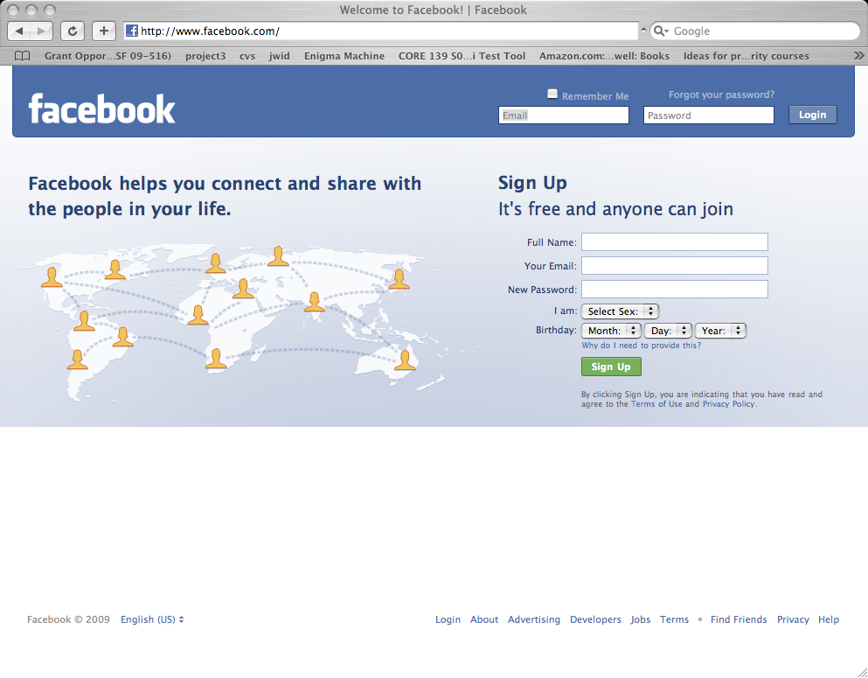
Example: Exploiting Social Network
1. Bad guy posts a message
2. When good guy reads the message, bad guy steals the cookie that contains information about authentication
Sep 2009
Information Security by Van K Nguyen Hanoi University of Technology

